Slide 1
Introduction to eduGAIN
eduGAIN Training Team
GÉANT GN5-2
eduGAIN training for ngREN April 2025
Notes:
Hello and welcome to this presentation providing you with an introduction to eduGAIN.
This module follows on from the previous module - introduction to Federated identity management, So please make sure you have completed it first.
You'll notice an audio icon in the corner of every slide which enables you to listen to the audio guide to accompany each slide.
We hope you enjoy this course and when you're ready please move on to the next slide to see the learning objectives.

Slide 2
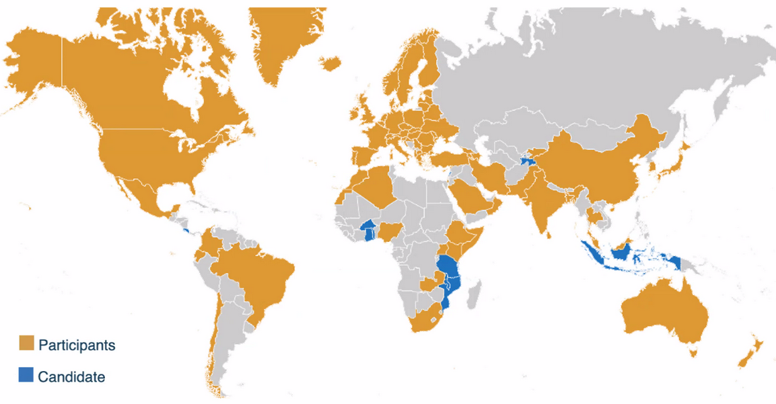
eduGAIN
Enabling access for the global research and education community
April 2025:
* 78 Active Federations
* 10 Candidate Federations
* 9700+ entities
Notes:
The main goal of this module is to establish an Identity Federation and join the eduGAIN Service. In previous sessions, we got familiar with the fundamentals of Federated Identity Management and its key components and now it is time to move to eduGAIN concept. eduGAIN is an inter-federation service. What does it mean?
It is a secure Single Sign-on service for global research and educational resources. Federated identities enable users to access a wide range of services using their account managed by their ‘home’ institution.
Currently eduGAIN is deployed in all 5 continents worldwide, it includes around 80 national identity federations and more than 9700 entities !

Slide 3
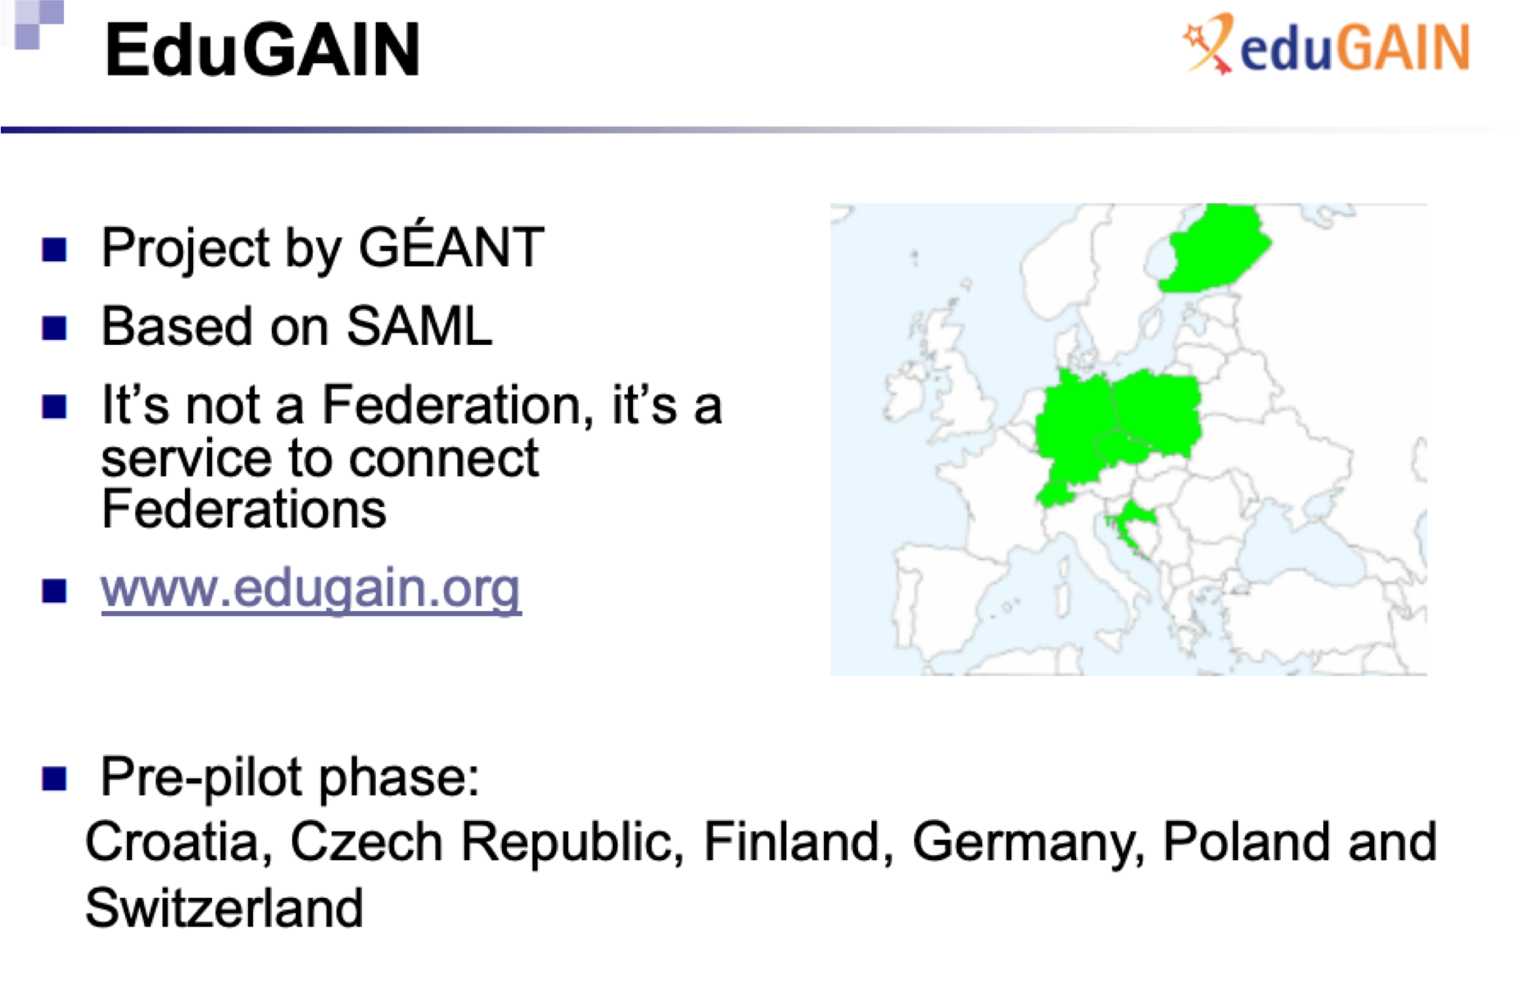
The beginning of eduGAIN
Notes:
eduGAIN started as a pilot project, in April 2011, as a service based on SAML protocol, that connects an initial set of Federations. It was a joint work between 6 members at a time: Croatia, Czech Republic, Finland, Germany, Poland and Switzerland. If you compare this size to the current number of federations and the worldwide coverage of this service, you will agree with us about its undeniable success !

Slide 4
What is eduGAIN?
•eduGAIN provides an efficient, flexible way for participating federations, and their affiliated users and services, to interconnect
•The eduGAIN Interfederation service is intended to enable the trustworthy exchange of information related to identity, authentication and authorisation between the member federations
•eduGAIN allows students and researchers to securely access a world of educational resources using a single sign-on
Notes:
There are some common definitions of eduGAIN:
eduGAIN provides an efficient, flexible way for participating federations, and their affiliated users and services, to interconnect. You can register a service in eduGAIN and open it to users from other countries around the world.
The eduGAIN Interfederation service is intended to enable the trustworthy exchange of information related to identity, authentication, and authorisation between the member federations. eduGAIN provides policy framework and standards to build trust between federations.
eduGAIN allows students and researchers to securely access a world of educational resources using a single sign-on and that is the main goal of eduGAIN.

Slide 5
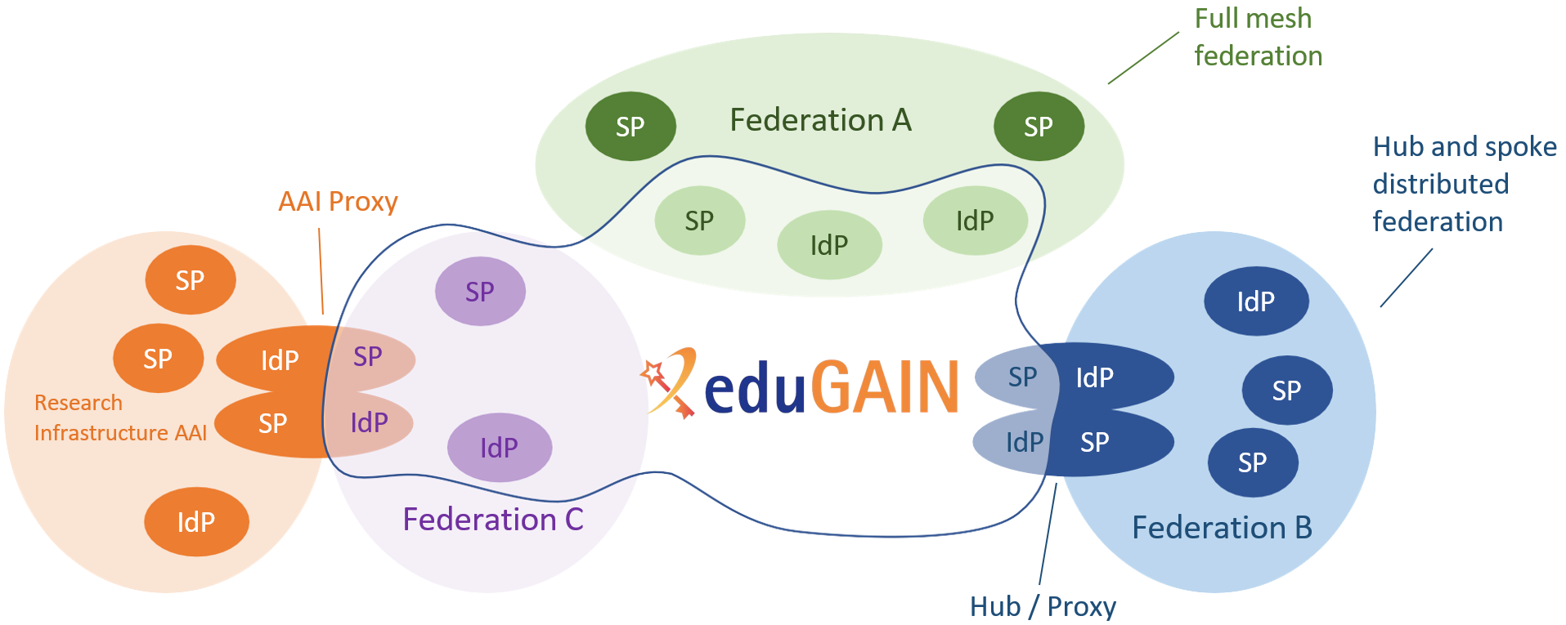
eduGAIN
The eduGAIN is an inter-federation service that connects identity federations around the world, simplifying access to content, services and resources for the global research and education community.
Notes:
As mentioned in the previous course, today eduGAIN is a complex ecosystem, acting as an interfederation service that connects identity federations around the world, simplifying access to content, services and resources for the global research and education community. eduGAIN comprises around 80 participant federations connecting more than 9,000 Identity and Service Providers.
eduGAIN provides policy framework and standards to build trust between federations.

Slide 6
Who benefits from eduGAIN?
Identity Federations
Identity Providers
Identity Holders (users)
Service Providers
Notes:
Let’s talk about the stakeholders that benefit from using eduGAIN.
One of them are Federations. By using eduGAIN there are more services for your users, it enables them to access services from different federations. It reduces the administrations costs, it saves time and increase trustworthiness by securing collaboration and information exchange
Furthermore, Service Providers have benefits as well. You as a Service Provider can offer the service to a greater number if users. It also lowers the cost per user, your audience grow without increasing the demand for user support.
Moreover, for Identity providers it allows your users to access a wider range of services. There is no extra administrative burden if you already participating in a federation with Web Single Sign On set up.
And last, but not least, students, researchers, educators, administrators can use one digital identity for all services in eduGAIN. eduGAIN is invisible for them and they can access wide range of services without extra effort.

Slide 7
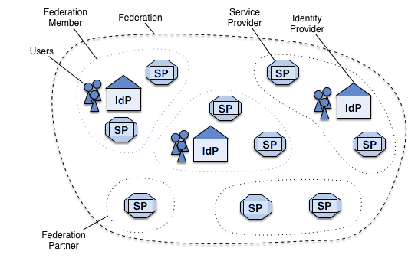
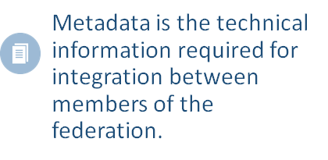
What is an Identity Federation?
An Identity Federation is a collection of organizations that agree to interoperate under a certain rule set.
Notes:
eduGAIN connects identity federations around the world, but It may be useful to remind ourselves about what an identity federation is and how it works. An identity federation is a collection of organizations that agree to interoperate under a certain rule set, which consists of legal frameworks, policies and technical profiles and standards. On top of this set of rules that guarantees the interoperability among all the parties, the Identity Federation provides the necessary trust and security to exchange home organizations’ identity information to access services within the federation.
IdPs and SPs "know" nothing about federations They read metadata! Metadata is configuration data used to provision an SP or IdP to communicate with each other. Typically it exists in XML form, at least for publishing and interchange.
An organization may belong to more than one federation at a time.

Slide 8
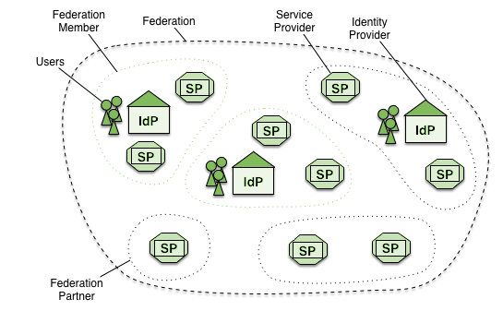
Inter-federation access
Notes:
To understand why eduGAIN is useful, let’s consider a simple inter federation access scenario with just two identity federations. In the blue federation we have a user that needs to access a resource published in the federation green. Unfortunately that is not possible: only the users of the identity providers that are members of the federation green are able to access resources protected by Service Providers registered in that federation. It is true that a Service Provider can choose to register in multiple federations, the green and the blue, but that is an additional burden for both the Service Provider and the Federations, and it would mean repeating the same registration procedures for hundreds or thousands of services multiplied by the number of worldwide federations.

Slide 9
Entities, metadata and Identity Federation
Entities register metadata
The Federation provides the metadata feed
Signing & Distribution of the metadata feed
Notes:
So in order to participate in an interfederation,, Participating Entities register their metadata into the Federation
The Federation validates and aggregates all the entities'metadata creating one or more federation feed
The Federation feeds are signed with the Federation key and distributed through an MDS (Metadata Distribution System)

Slide 10

eduGAIN Metadata Distribution Service
Federations’ metadata upstream feed
eduGAIN metadata creation
eduGAIN metadata signing and distribution
Federations redistribute the eduGAIN metadata
Metadata Distribution Service
Upstream Federation Metadata
1
A
B
1
MDS
IdP
SP
IdP
SP
SP
Federation A
2
Federation B
4
4
3
3
Federation Metadata
eduGAIN Metadata
Notes:
eduGAIN enables inter-federation access to resources through its Metadata Distribution Service.
1. Participating Federations provide an upstream federation metadata aggregate of entities to be exported to eduGAIN
2. Federations’ metadata aggregates are picked up, validated and aggregated in the so called eduGAIN metadata feed
3. The eduGAIN feed is signed with the eduGAIN key and distributed to Federations through the eduGAIN MDS
4. Federation pulls eduGAIN metadata, aggregates, signs and publishes in federation metadata for its members

Slide 11
A complex ecosystem
Notes:
Nowadays, eduGAIN supports a complex ecosystem of Authentication and Authorisation Infrastructures composed by national identity federations and large international research infrastructure. The entities themselves are not limited anymore to just Identity and Service Providers, in fact there are also proxies providing access to resources for research collaborations as well as gateways to social login and eGOV-ID infrastructures.

Slide 12
Thank You
Notes:
Thank you very much. Please move to the next module.

